Slide 1
DSA Project
Persistent data structures

Slide 2
What Is Our Project?
People use GitHub on a daily basis, a place to store code with all the revision history they need.
Git specifically works by taking snapshots of files, if files remains unchanged in a particular version, it simply links to the previous files. This keeps everything fast and lean.
In our project also, we have implemented Git like structure.
The user has a directory with the options of adding, deleting, viewing and editing files.
They can branch out at anytime, preserving the previous state in such a way that it can be accessed and modified when needed.
To achieve this we are using Persistent Binary Search Trees.

Slide 3
Persistent Data Structures
During the course of an algorithm, we sometimes find that we need to maintain past version of dynamic set as it is updated, we call such a set persistent.
A Persistent data structure is a data structure that always preserves the previous version of itself when it is modified.
A data structure is Partially persistent if all versions can be accessed but only the newest version can be modified.
A data structure is Fully persistent if every instance can be both accessed and modified.
Persistence can be achieved by simply copying, but this is inefficient in CPU and RAM as most operations will make only a small change in the Data Storage.

Slide 4
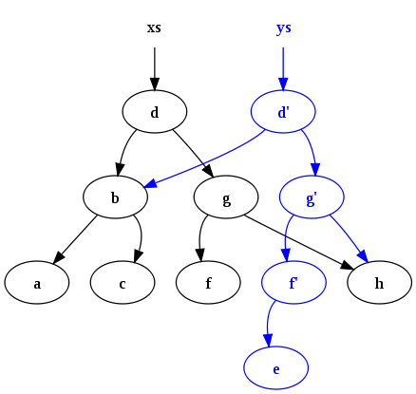
How are we using it?
Here we are implementing Fully persistent data structure on Binary Search Trees.
Any operation performed takes time in the order of the height of the tree{O(h)}.
We can access and make changes in the previous versions of the file in different branches.

Slide 5
Insert and Delete
While inserting, we make a copy of all the nodes which are affected by the insertion in the current branch.
This is done to ensure that the changes are only made to the current branch and it does not affect the other branches.
All the other nodes are reused in this way and memory is saved.
Finally when we reach the leaf, we insert the node there according to the BST property.
Similarly while deleting, a copy of all the affected nodes is made.

Slide 6
Project Structure
There is a “PBST” class object which represents the main tree.
It has an attribute “branches” where pointer to the root of every branch is stored.
It is a menu driven program where we work on one branch at a time and can add, view, delete, search and edit files in that branch.
We can branch out from this branch or switch between the branches whenever needed.

Slide 7
Group Members
Mahim Agrawal 16IT152
Dhvanil Parikh 16IT217
Sanjay Shetty 16IT136
Nishant Kumar 16IT123

